Slide 1
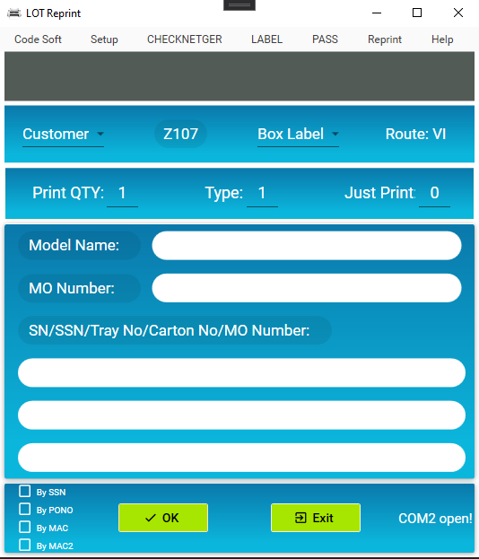
1.Open program
Use SFIS_AMS 5.0 to download and run program.
Call procedure: SFIS1.LOT_REPRINT_PROGRAM

Slide 2
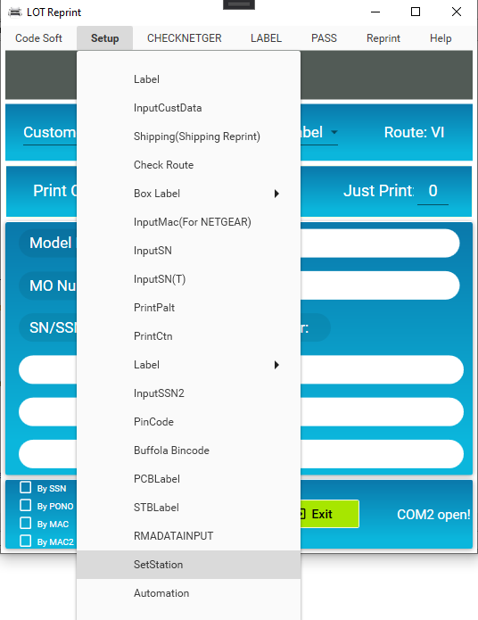
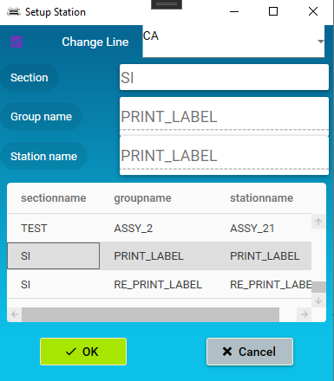
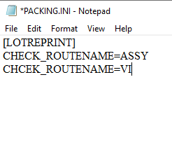
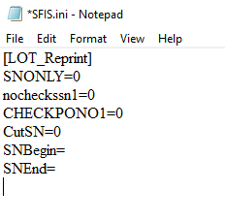
2.Setup station
The program will save the station value in File(C:\PACKING\Packing.ini)
File(C:\Windows\SFIS.ini)

Slide 3
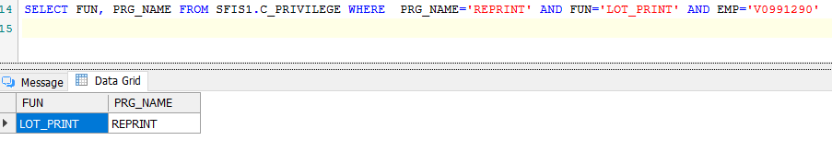
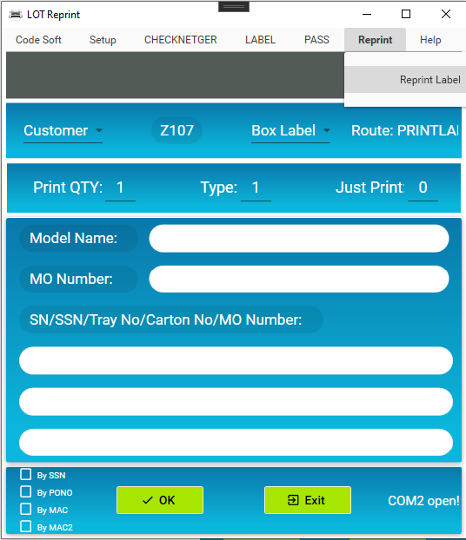
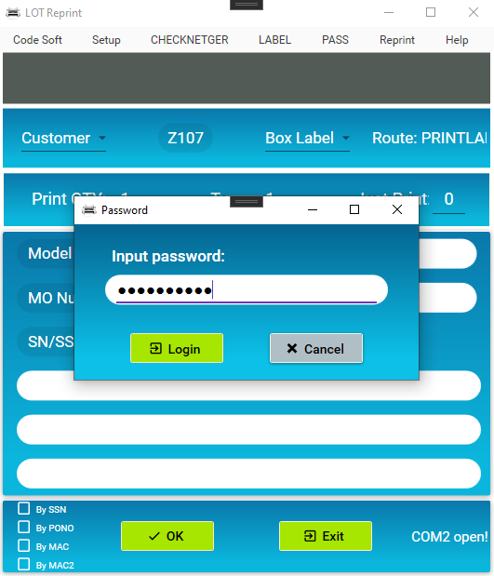
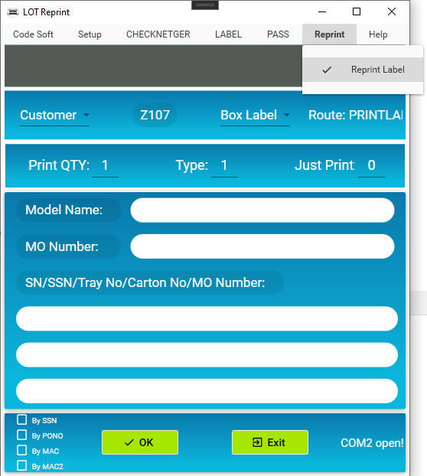
3. Reprint
Reprint by employee have login privilege

Slide 4
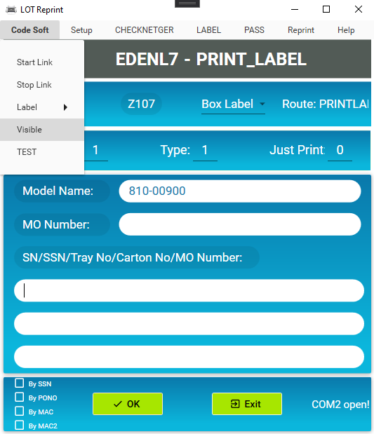
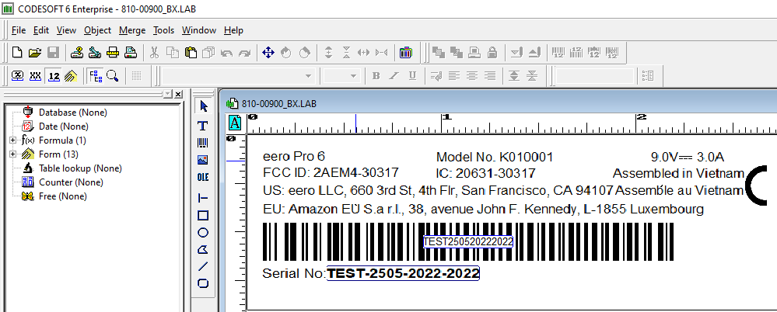
4. Label and Visible label
Using Label Checking system to manage.
Visible label using CODESOFT to display value and variables in Label.

Slide 5
2021 FG IT Weekly Meeting 資訊管理部報告

